Slide 1
Mon., 12/8 -C
DUE:
WARM UP – what types of fences can you list? What is the purpose of fences? Describe the fences in your lives?

Slide 2




WARM UP – Describe the character traits evident in these images – what is your proof?

Slide 3
Picture yourself in 5 years
Where do you see yourself in five years? Name and describe a specific place.
What are you doing with your life in five years? How do you see yourself spending your 9–5 time?
What is the biggest physical change in you from your high school self? In other words, at your high school reunion, what will people notice first about you?
What is your general attitude toward life? Are you content? Satisfied? Hopeful? Disillusioned? confused? dissatisfied?
What do you miss most about your high school self and/or your high school life?

Slide 4
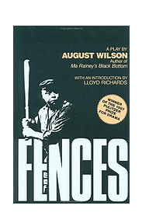

Notice?? Wonder?

Slide 5
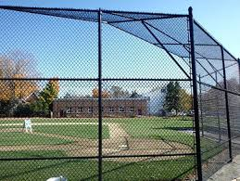
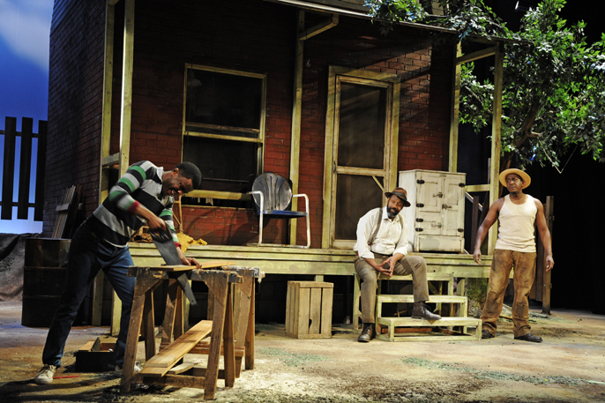
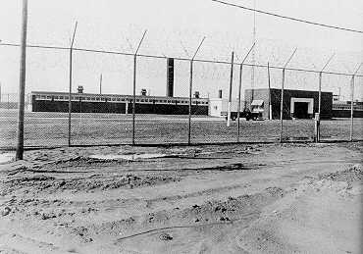
SETTING
1957, Pittsburgh, PA, small dirt yard of the Maxson home, with a half-fenced yard and a tree with a bat and rag ball.
9 Scenes – 9 innings
3 Strikes

Slide 6
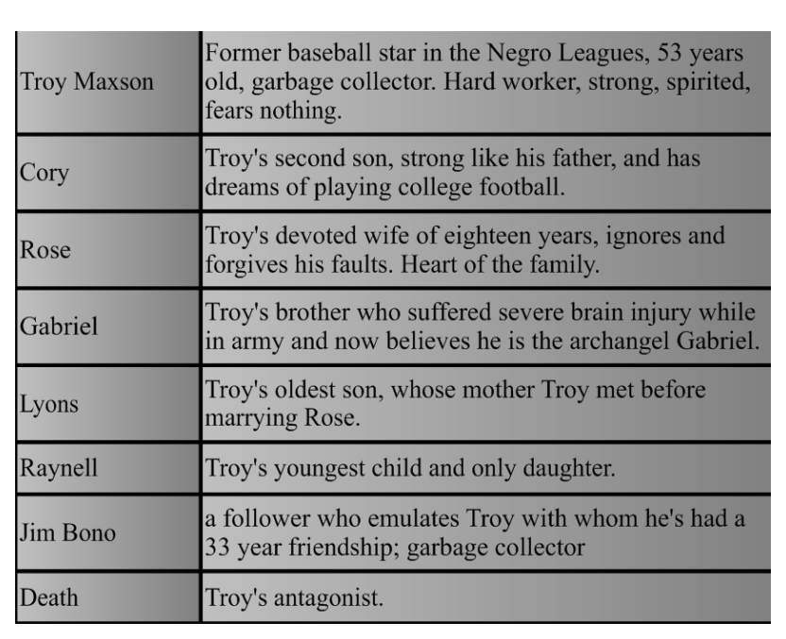
Characters in Fences, a dramatic play by August Wilson

Slide 7
Citation – works cited
Wilson, August. Fences. New York: Penguin Books, 1986.

Slide 8
Tue., 12/9 -D
HW: Journal Entry #1
DUE: Missing Work– please check your grades on ParentConnect
WARM UP – Read and ANNOTATE passage on Lloyd Richards-
use ! For interesting Facts, ? For Questions and # for connections to Fences notes.
Learning Targets
I can annotate for information.
I can contribute to a discussion.
I can stay on task.
I can build background knowledge to help me inform my understanding of Fences.

Slide 9
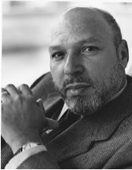
Wednesday, Dec. 10 – A - Day
Thinking about our discussion on “fences” yesterday, reflect on the following questions:
How are cultural/language groups affected differently by fences? Do different groups have different fences?
Can someone have access to “both sides of the fence”? How?

Slide 10
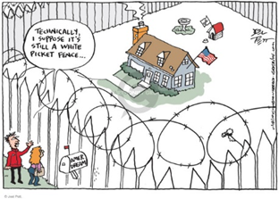

Slide 11
HW: Entry #1
Write one page on the term 'nigger'.
How is it a racist term?
How is it used?
Why, if it is such a negative term, does the main character use it?
How do you hear it used?
How is it both empowering and self-defeating to use it?

Slide 12
Thur., 12/11 -B
HW: Journal Entry #2
DUE:Missing Work by 12/15– please check your grades on ParentConnect
WARM UP – Discuss the questions in your group. Be prepared to share out.
Learning Targets
I can contribute to a discussion.
I can stay on task.
I can build background knowledge to help me inform my understanding of Fences.

Slide 13
Sensitive language and diverse classrooms
How might “dialect” be challenging? How might “dialect” be empowering for some students?
Why is it important to expose students to literature that reflects different ways of talking and knowing?
Is the n-word profanity? Should it be “allowed” at school?
Who can say the n-word and who can’t?

Slide 14
HW: Entry 2
Write one page on what keeps people from succeeding in life.
How does racism keep people down?
How does poverty keep people down?
How does gender keep people down?
What can people do to change their future?
Can people overcome hardships?
Do you believe what teachers tell you about education?
What do you believe will help you succeed?
How much do you really care about success?
What is success to you?

Slide 15
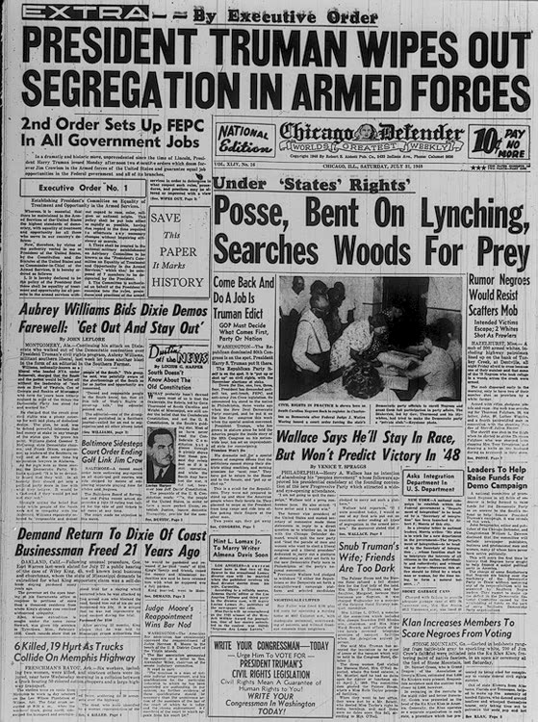
Newspaper Source – FOUND POEM

Slide 16
Creating a FOUND POEM
Found poems take existing texts and refashion them, reorder them, and present them as poems. The literary equivalent of a collage, found poetry is often made from newspaper articles, street signs, graffiti, speeches, letters, or even other poems.
A pure found poem consists exclusively of outside texts: the words of the poem remain as they were found, with few additions or omissions. Decisions of form, such as where to break a line, are left to the poet.

Slide 17
Negroes
Segregation
Friends are too dark
Klan increases members to scare negroes
Bent on lynching
Civil rights legislation
Searches woods for prey
Scatters mob
Negroes would resist
Save this paper
Marks history
Wipes out segregation
Sidesteps Jim Crow
Demand
Order
Rumor

Slide 18
Fri., 12/12 - C
HW: Journal Entries 1 &2
DUE:Missing Work by 12/15– please check your grades on ParentConnect
WARM UP – Write a page on how parents should prepare their children for life.
How does Troy deal with Lyons?
How does Rose deal with Lyons?
Which one will help Lyons deal with life?
What do your parents do?
What things do some parents do that don't really help?
What would you do if you were a parent?
What would you try to teach your children?
What skills do they need?

Slide 19
Entry 3
Write one page on how parents should prepare their children for life.
How does Troy deal with Lyons?
How does Rose deal with Lyons?
Which one will help Lyons deal with life?
What do your parents do?
What things do some parents do that don't really help?
What would you do if you were a parent?
What would you try to teach your children?
What skills do they need?

Slide 20
Essential Understandings
People can create barriers to give themselves a sense of security, but those barriers can prevent them from growing or experiencing their dreams.
Coming of Age Within the Cycle of Damaged Black Manhood offers African Americans a unique challenge.
Conflict can arise when people are at odds with the way they Interpret and Inherit History.
People sometimes choose between the Survival Mechanisms of Pragmatism (Realism) and Illusions.

Slide 21
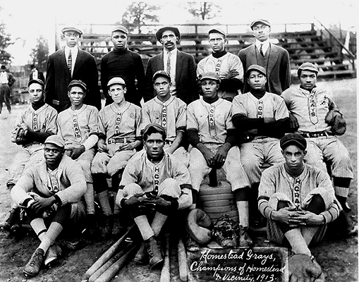
The Hill District: 1913 Homestead Grays
Caption: "In 1910, 'Cap' Posey's son, Cumberland W. Posey, organized a group of Homestead steelworkers into what was to be one of baseball's greatest clubs and gate attractions. In later years the Homestead Grays, playing at Forbes Field here and Griffith Stadium in Washington, won eight out of nine Negro National League titles. Among its stars was the mighty home-run hitter, Josh Gibson. 'Cum' Posey, an outstanding athlete at Penn State and Duquesne University, is shown (third from left, center row) with his 1913 team."
Photographer: Date: 1913. Heading: Pittsburgh. Sports. Baseball.

Slide 22
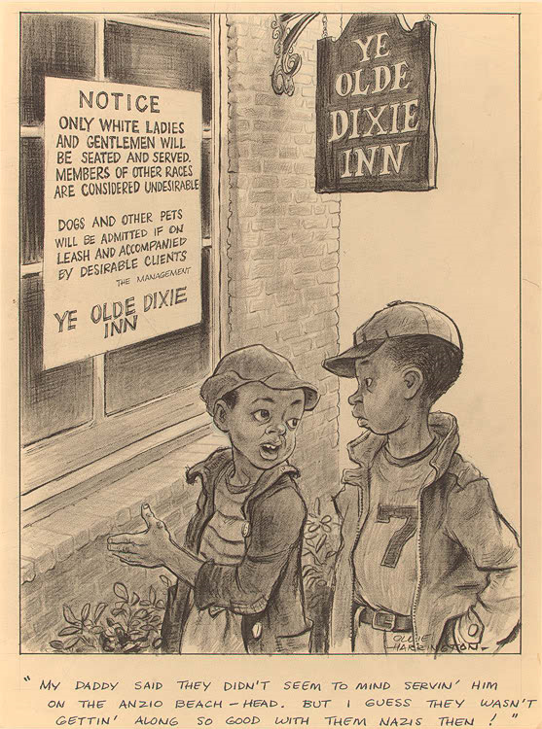
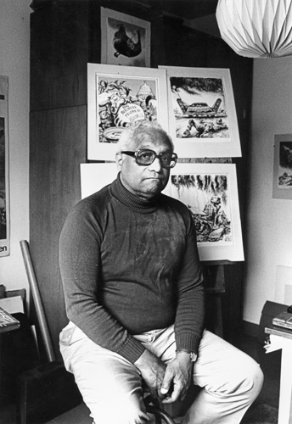
Oliver W. Harrington (1912-1995) knew he wanted to become a cartoonist during grade school, when drawing caricatures made him feel better about disturbing situations. Harrington received a Bachelor of Fine Arts degree from Yale University. In 1951, he left the United States, but continued to provide cartoon strips for American newspapers. His images address the social and political injustices of capitalism and racism. Harrington's Dark Laughter strip first appeared in The Amsterdam News in May 1935.
Oliver Wendell "Ollie" Harrington (February 14, 1912 – November 2, 1995) was an American cartoonist and an outspoken advocate against racism and for civil rights in the United States. Of multi-ethnic descent, was called by Langston Hughes "America's greatest African-American cartoonist," an assessment that has stood the test of time.^{[1]} Harrington requested political asylum in East Germany in 1961; he lived in Berlin for the last three decades of his life.

Slide 23
Entry 4
Write one page on the topic of obstacles.
What is it that Troy says has kept him from getting ahead?
What other things may be getting in Troy's way?
What is he doing to his son Cory?
Why is he creating obstacles for Cory?
Do you think going to college to play football would help Cory?
What about if he didn't even pass or graduate?
What could Cory learn about the world that would help him if he could only get away from home?
How are Gabe and Lyons better off than Cory?

Slide 24
Entry 5
What does Bono say about what Troy is doing to his own life?
How is Rose trying to protect the family?
How does Troy compare Alberta to the devil?
How is Troy's seeing Alberta just like his not finishing the fence?

Slide 25
Entry 6
Write one page on the topic of responsibility.
What is responsibility?
What is responsibility doing to Troy?
How is Lyons rebelling against responsibility?
How is Gabe taking on an unrealistic amount of responsibility?
How is responsibility affecting Rose?
What are Cory's choices?
Can a person have both responsibility and dreams?
How do you feel about the responsibilities you have in your life?

Slide 26
Entry 7
Write one page on the topic of the blues.
What are the blues?
How do each of the characters have the blues:
Troy
Rose
Cory
Gabe
Lyons
Bono
Can a person become comfortable with the blues and not want it another way?
What do people do to fight the blues?

Slide 27
Entry 8
Write one page on the topic of satisfaction.
When is something good enough?
When should you work to make things better?
What was not good enough for Troy?
In what ways was it good enough for Rose?
In what ways could it have been better for each of them?
What do you think of the American idea of success?
Does success equal satisfaction?
Do you think that having everything you need will satisfy you? What will?.

Slide 28
Entry 9
Write one page on the topic of betrayal.
How does Troy betray Rose?
How does Rose react to his betrayal?
How has Troy betrayed his sons also?
Why doesn't Troy see this as betrayal?
How can Troy go on seeing Alberta and living with Rose?
How can Rose live with it?
How do you deal with betrayal?
In what ways are you vulnerable to betrayal in your life?
What tools do people have to deal with betrayal?

Slide 29
Entry 10
Write one page on the topic of resolution.
How does Rose resolve her problem with Troy?
How well does this resolution work for her?
How well does it work for Troy?
Is a problem resolved if only one person can live with the outcome?
What problem does Cory have?
How can he resolve it?
What problems do Lyons and Bono have?
How do you resolve problems?
How can people reach a final resolution of their problems?
Entry 12: Write one page on the topic of how this unit supports the WOIS value of Compassion and Integrity.
"We at Stratford High School represent a diverse and dynamic learning community and encourage respect for the uniqueness of each individual. Our mission is to develop intellectually, emotionally, and ethically mature citizens prepared to meet ever-changing personal and global challenges within a safe, academically challenging, and socially enriching environment.

Slide 30
Entry 12
Entry 12: Write one page on the topic of how this play supports the WOIS value of Compassion and Integrity.

Slide 31
Possible Essay Topics
1. Discuss the symbolism and thematic significance(s) of "fences."
2 . Examine the use of songs and singing in the play. When and how are songs used to convey ideas, themes or character?
3 . Explain how Fences can be read as a form of social commentary. What is the social, political and historical context? What is Wilson saying about the context?
4 . Examine Wilson’s treatment of family relationships, especially the relationships between men and women and fathers and sons.
5 . Explain how Wilson uses baseball to advance themes and ideas. What is conveyed through baseball? What is the significance of football?
6 . Describe the role of money in this play. What is Wilson saying about money? Who has it? Who controls it? Who doesn’t have it?
7 . Analyze the references to and occurrences of death.
8 . Do a character analysis of Troy. What traits does he have? How do these character traits affect his life, friendships, life choices, and his relationships with others?
9 . Examine the depiction of women and the lives of the women characters. What is Wilson saying about gender?
10 . How does race and racism inform the play? Can this play be read as a commentary on race and racism in America? How? Why?

Slide 32
Learning Targets:
I can support my argument with CLAIM BASED EVIDENCE.
I can write a well developed paragraph about ONE controlling Idea using specific details from a text.
I can write a well developed paragraph about ONE Literary Technique using specific evidence from a text.
Warm UP: Use “TO JAMES” and “EX-BASKETBALL PLAYER” to write your paragraph.
26 Write a well-developed paragraph in which you use ideas from both passages to establish a controlling idea about goals. Develop your controlling idea using specific examples and details from each passage.
Please work by yourself – this is an assessment. YOU MAY USE YOUR NOTES – THIS TIME.

Slide 33
Question 26 Directions
26 Write a well-developed paragraph in which you use ideas from both passages to establish a controlling idea about goals*. Develop your controlling idea
using specific examples and details from each passage.

Slide 34
Learning Targets:
I can read with purpose
I can respond to ideas with CLAIM BASED EVIDENCE
Warm UP:
Under DISCUSSION NOTES:
Rewrite the following quote: “The human heart has ever dreamed of a fairer world than the one it knows.” ― Carleton Noyes
Interpret the quote in your own words
Explain how “The Necklace,” by Guy de Maupassant, or “Fences,” by August Wilson, supports your interpretation
Label the LITERARY ELEMENT you see evident in your explanation
Write the TAG of another work of literature which would ALSO support your interpretation

Slide 35
Critical Lens
Guidelines: Be sure to: ~ Provide a valid interpretation of the critical lens that clearly establishes the criteria for analysis ~ Indicate whether you agree or disagree with the statement as you have interpreted it ~ Choose two works you have read that you believe best support your opinion ~ Use the criteria suggested by the critical lens to analyze the works you have chosen ~ Avoid plot summary. Instead, use specific references to appropriate literary elements (for example: theme, characterization, setting, point of view) to develop your analysis ~ Organize your ideas in a unified and coherent manner ~ Specify the titles and authors of the literature you choose ~ Follow the conventions of standard written English

Slide 36
Learning Targets:
I can read with purpose
I can understand the motivations of a character
I can respond to ideas with CLAIM BASED EVIDENCE
Warm UP:
Under DISCUSSION NOTES:
Reflect on how the following statement about discipline applies to you –
In the journey toward mastery, discipline is the path, which leads to total artistic freedom. With clear purpose, hours and days are spent practicing over the course of years, in isolation, developing the skills, technique, and knowledge that give both power and ease to expression. What begins as a struggle, a challenge, a chore, evolves into a ritual, a daily rhythm, a source of confidence and calm. No discipline seems pleasant at the time, but painful. Later on, however, it produces a harvest of rewards for those who have been trained by it. The path to discipline is a life long journey. (Karine Stone and John Ra)

Slide 37
Question 26
Please review your comments on your “GOALS” paragraph – write down one area in which you will continue to discipline yourself as we get closer to August 13.

Slide 38
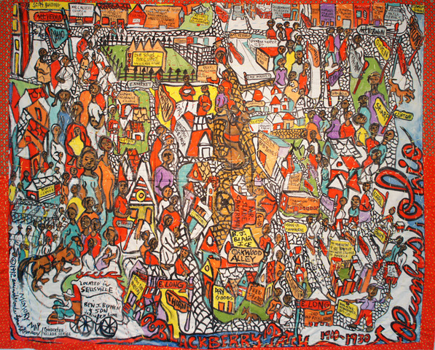

Slide 39
Guiding Questions for Fences
Ghetto Child by Shamekia Copeland
Develop a controlling idea about adversity (hardship) from Passage 1 (Fences) and Passage 2 (Ghetto Child).
How does poverty play a role in the struggles of the Maxson family?
How might Cory change the cycle of poverty within the Maxson family?

Slide 40
Learning Targets:
I can support my argument with CLAIM BASED EVIDENCE.
I can write a well developed paragraph about ONE controlling Idea using specific details from a text.
I can write a well developed paragraph about ONE Literary Technique using specific evidence from a text.
Warm UP:
Under DISCUSSION NOTES:
Rewrite the following quote: “The right good book is always a book of travel; it is about a life’s journey .” ― HM Tomlinson
Interpret the quote in your own words
Explain how “The Necklace” by Guy de Maupassant supports your interpretation
Label the LITERARY ELEMENT you see evident in your explanation
Write the TAG of another work of literature which would ALSO support your interpretation

Slide 41
Main Action of Act 1 Scenes 1 & 2
Scene 1
Scene 2
Troy upset that he can’t drive the garbage truck
Lyons asks Troy for $10
Troy uses Gabe’s money to pay for house “roof over my head”

Slide 42
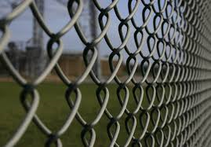
Emotional Fences
What fences exist between Troy and Lyons?
What fences exist between Troy and Gabriel?
Troy let Lyons down because Troy wasn’t there when he was growing up (Person vs Person-External)
Troy feels like he used Gabe for the money, and he feels like less of a man (Troy vs his conscience/shame/manhood/pride)

Slide 43

Learning Targets:
I can express my understanding of an important event in a literary work.
I can determine a plan of action to prepare for August 13.
I can write a well developed introductory paragraph for a Critical Lens statement.
I can read with purpose and tone.
Warm UP:
Following up with NOTES from yesterday about Main Action in the Scenes from Fences:
What is the MAIN Action of Act 1 Scene 3
Describe the “fence(s)” that exist between Troy and Cory

Slide 44
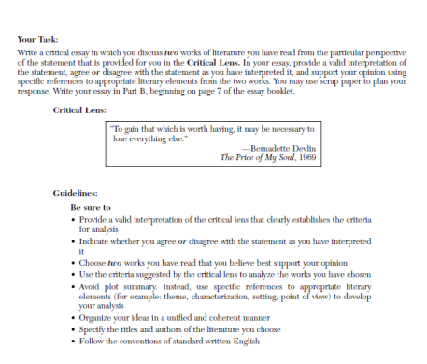
Question 28 – Critical Lens
“To gain that which is worth having, it may be necessary to lose everything else.” –Bernadette Devlin

Slide 45
The REAL Approach
Restate
Explain
Agree/Disagree
List Literature and Literary Elements
Be REAL!

Slide 46
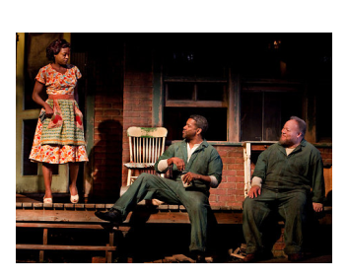
Act 1 Scene 5
Actors take your places

Slide 47
Motifs, Symbols, Allegory
Motifs- a detail within the text that repeats itself throughout the work
Symbols – represents a figurative meaning
Death and Baseball
Seeds and Growth
Blues
Trains
Fences
The Devil
Allegory – represents a double meaning throughout the length of the story – Fences (Literal/Figurative)
Fences are physical structures that we build to keep things in/out
Fences are emotional barriers that we build to keep feelings in/out

Slide 48
Themes
Review the Main Action of each of the NINE Scenes in Fences, and determine which of the following topics fit each of the Main Actions. Then write the author’s MESSAGE about the TOPIC. (Q26)
What is August Wilson’s message about:
Control, Power
Black manhood
Death
Love
Race
Survival
Father and Son relationships
American Dream
Duty, Responsibility
Family
Other?

Slide 49
Mending Walls – Robert Frost
There where it is we do not need the wall: He is all pine and I am apple orchard. My apple trees will never get across And eat the cones under his pines, I tell him. He only says, 'Good fences make good neighbors'. Spring is the mischief in me, and I wonder If I could put a notion in his head: 'Why do they make good neighbors? Isn't it Where there are cows? But here there are no cows. Before I built a wall I'd ask to know What I was walling in or walling out, And to whom I was like to give offence. Something there is that doesn't love a wall, That wants it down.' I could say 'Elves' to him, But it's not elves exactly, and I'd rather He said it for himself. I see him there Bringing a stone grasped firmly by the top In each hand, like an old-stone savage armed. He moves in darkness as it seems to me~ Not of woods only and the shade of trees. He will not go behind his father's saying, And he likes having thought of it so well He says again, "Good fences make good neighbors."
Something there is that doesn't love a wall, That sends the frozen-ground-swell under it, And spills the upper boulders in the sun, And makes gaps even two can pass abreast. The work of hunters is another thing: I have come after them and made repair Where they have left not one stone on a stone, But they would have the rabbit out of hiding, To please the yelping dogs. The gaps I mean, No one has seen them made or heard them made, But at spring mending-time we find them there. I let my neighbor know beyond the hill; And on a day we meet to walk the line And set the wall between us once again. We keep the wall between us as we go. To each the boulders that have fallen to each. And some are loaves and some so nearly balls We have to use a spell to make them balance: 'Stay where you are until our backs are turned!' We wear our fingers rough with handling them. Oh, just another kind of out-door game, One on a side. It comes to little more:

Slide 50
Think about…
"Before I built a fence I would ask what it is I am walling in and walling out“
How will this apply to our protagonist?
https://www.youtube.com/watch?v=jzasX6UiGQQ

Slide 51
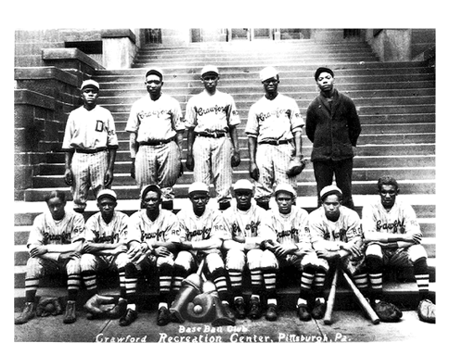
Negro League Baseball
Notes:
Photo shows when slide show plays

Slide 52
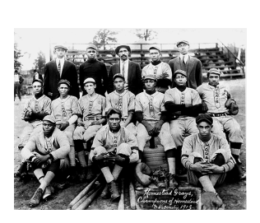
Notes:
Photo shows when slide show plays

Slide 53
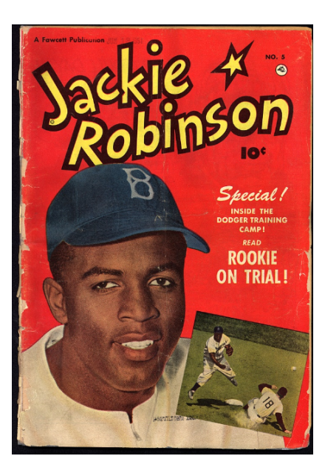
Jackie Robinson – No. 42
2007 was the 60th anniversary of Jackie Robinson's rookie season for the Brooklyn Dodgers. When he stepped onto Ebbets field on April 15th, 1947, Robinson became the first African American in the twentieth century to play baseball in the major leagues -- breaking the "color line," a segregation practice dating to the nineteenth century. Jackie Robinson was an extremely talented multi-sport athlete and a courageous man who played an active role in civil rights.

Slide 54
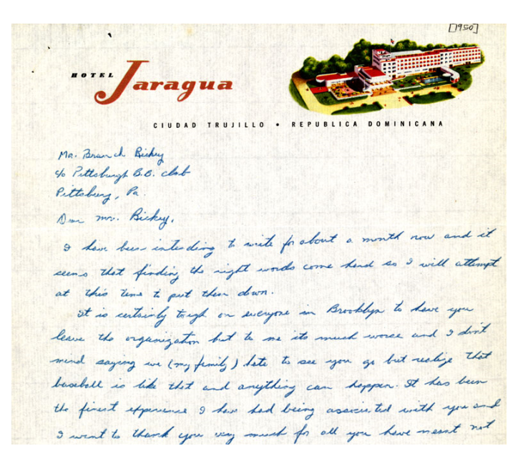

Slide 55
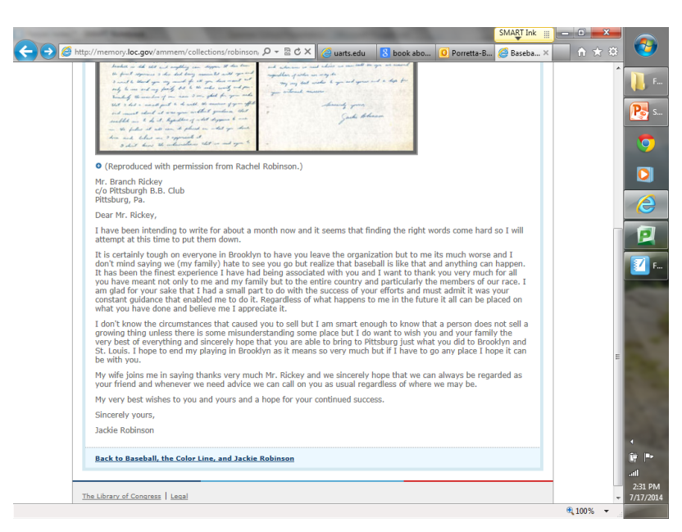

Slide 56
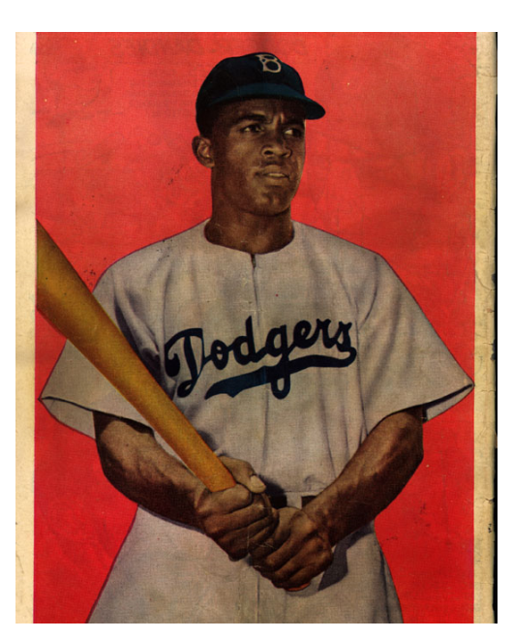

Slide 57
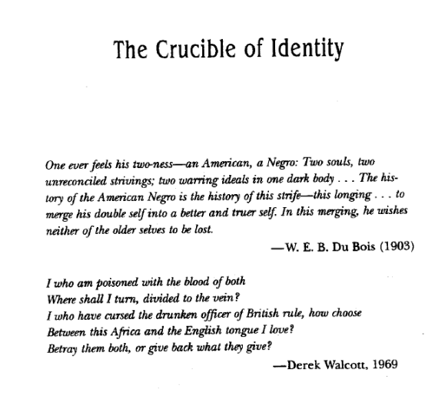

Slide 58
The Blues
August Wilson says he uses the language and attitude of blues songs to inspire his plays ?and play characters. The blues is a melancholy song created by black people in the United ?States that tends to repeat a twelve bar phrase of music and a 3-line stanza that repeats ?the first line in the second line. A blues song usually contains several blue, or minor, notes ?in the melody and harmony.
Fences is structured somewhat like a blues song. the play is like a key of music and the characters each have their own rhythm and melody. Characters repeat phrases, or pass phrases around, like a blues band with a line of melody. The repeated events and language of the play are in keeping what he calls a "blues aesthetic."

